Slide 1
DYNAMIC PROGRAMMING

Slide 2
Problem Statement
We are given an array Arr[] of length n. It represents the price of a stock on ‘n’ days. The following guidelines need to be followed:
We can buy and sell the stock any number of times.
In order to sell the stock, we need to first buy it on the same or any previous day.
We can’t buy a stock again after buying it once. In other words, we first buy a stock and then sell it. After selling we can buy and sell again. But we can’t sell before buying and can’t buy before selling any previously bought stock.

Slide 3
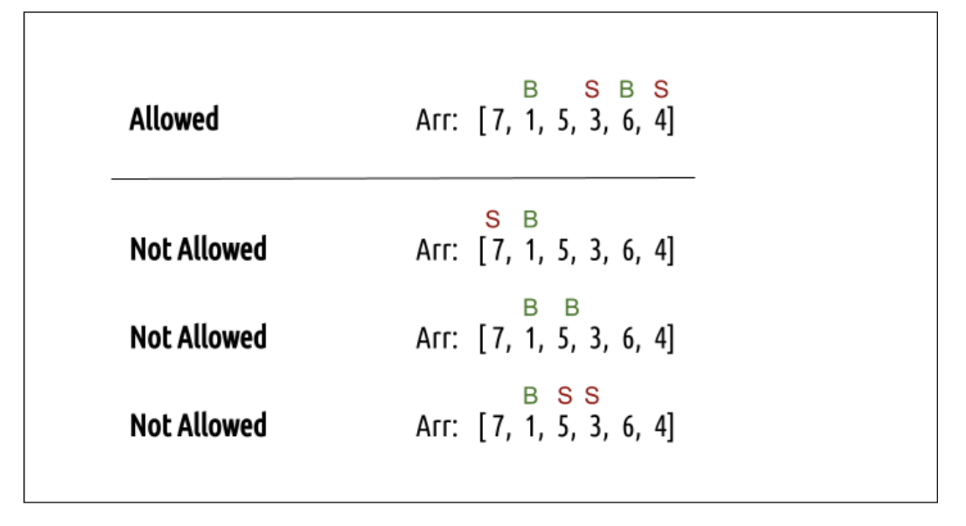

Slide 4
Subproblem Definition?

Slide 5
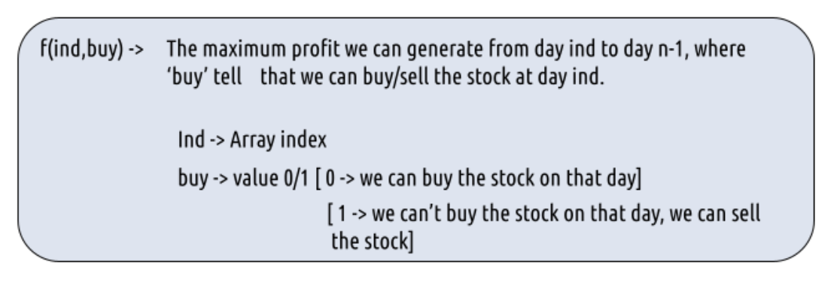
Subproblem definition

Slide 6
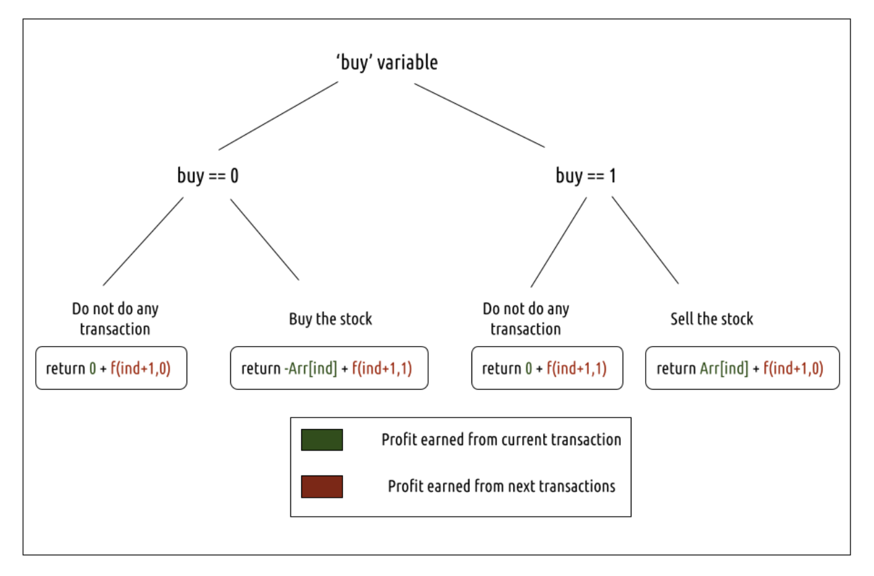
Why dynamic programming ? - overlapping subproblems

Slide 7
Recurrence Relation(s)?

Slide 8
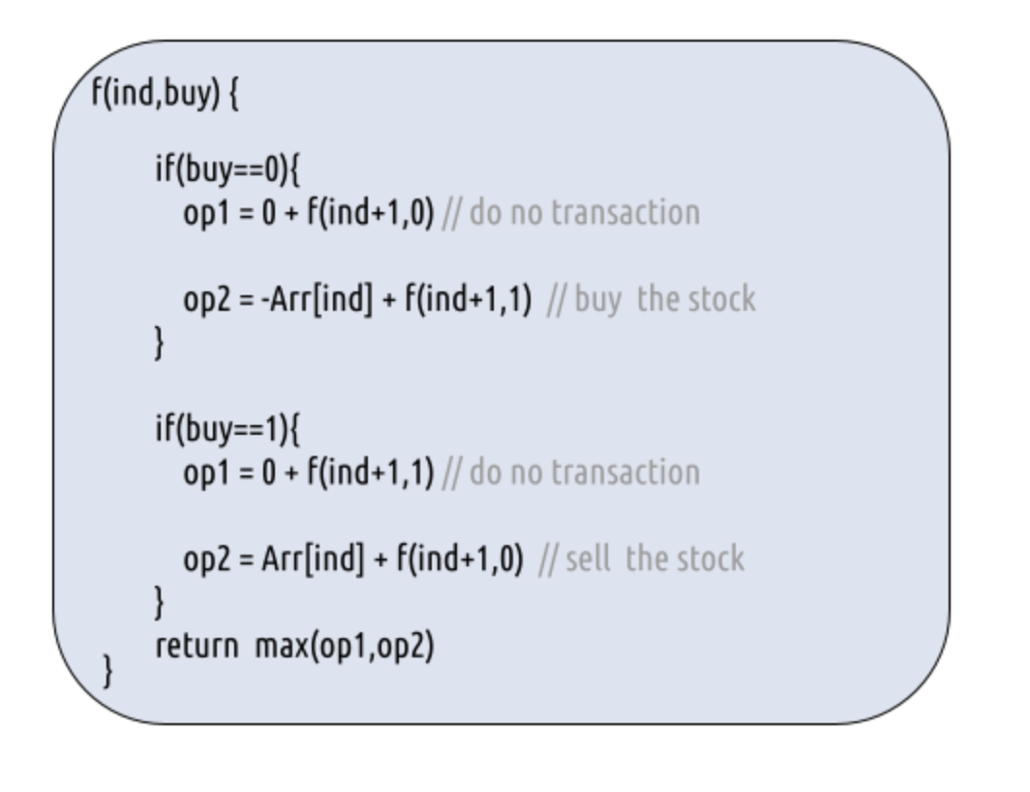
Recurrence relations
Base case - If ind==n, it means we have finished trading on all days, and there is no more money that we can get, therefore we simply return 0.

Slide 9
Pseudo-code
dp[n][0] = dp[n][1] = 0 // Base condition: If we have no stocks to buy or sell, profit is 0
profit = 0 // Iterate through the array in reverse to calculate the maximum profit
for ind from n - 1 to 0:
for buy from 0 to 1:
if buy == 0: // We can buy the stock
profit = max(0 + dp[ind + 1][0], -Arr[ind] + dp[ind + 1][1])
else if buy == 1: // We can sell the stock
profit = max(0 + dp[ind + 1][1], Arr[ind] + dp[ind + 1][0]) dp[ind][buy] = profit
return dp[0][0] // The maximum profit is stored at dp[0][0]

Slide 10
Complexities
Time Complexity - O(2*n)
Space Complexity - O(2*n) (can it be reduced?)

Slide 11
Problem Statement
We are given an array Arr[] of length n. It represents the price of a stock on ‘n’ days. The following guidelines need to be followed:
In order to sell the stock, we need to first buy it on the same or any previous day.
We can’t buy a stock again after buying it once. In other words, we first buy a stock and then sell it. After selling we can buy and sell again. But we can’t sell before buying and can’t buy before selling any previously bought stock.
We can do at most 2 transactions.

Slide 12
Subproblem Definition?

Slide 13
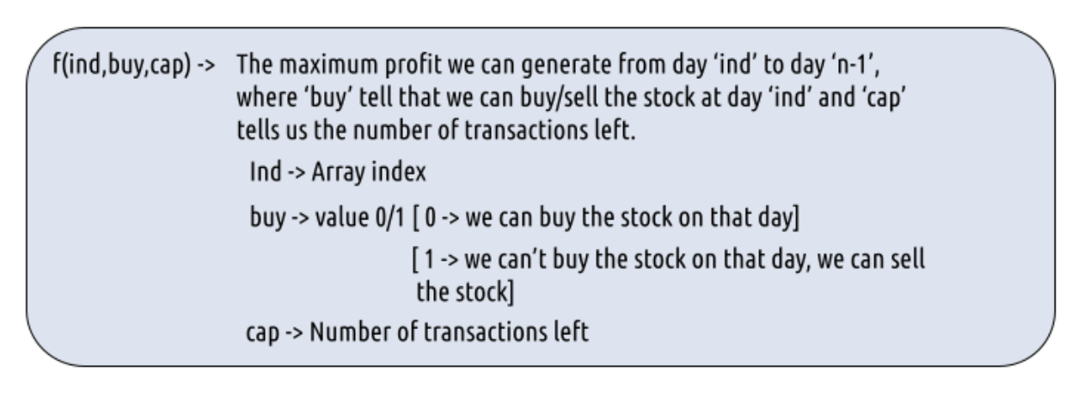
Subproblem definition

Slide 14
Recurrence Relation(s)?

Slide 15
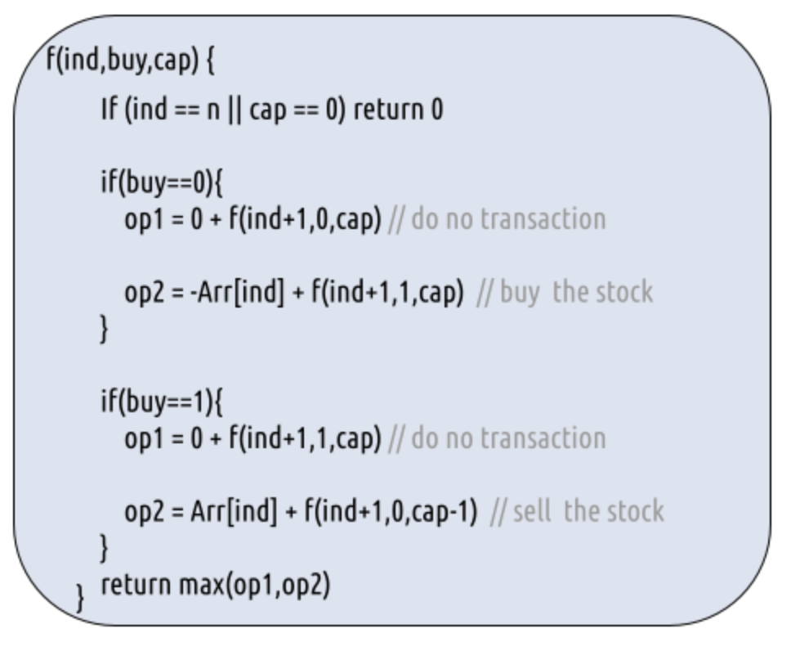
Recurrence relations and base case

Slide 16
Pseudo-code
dp[ind][buy][cap] = 0 wherever cap == 0 or ind == n
for ind from n - 1 to 0:
for buy from 0 to 1:
for cap from 1 to 2:
if buy == 0: // We can buy the stock
dp[ind][buy][cap] = max(0 + dp[ind + 1][0][cap], -prices[ind] + dp[ind + 1][1][cap])
else if buy == 1: // We can sell the stock
dp[ind][buy][cap] = max(0 + dp[ind + 1][1][cap], prices[ind] + dp[ind + 1][0][cap - 1])
// The maximum profit with 2 transactions is stored in dp[0][0][2]
return dp[0][0][2]

Slide 17
Complexities
Time Complexity - O(n*2*3)
Space Complexity - O(n*2*3) (can it be reduced again?)

Slide 18
Problem Statement
We are given an array Arr[] of length n. It represents the price of a stock on ‘n’ days. The following guidelines need to be followed:
We can buy and sell the stock any number of times.
In order to sell the stock, we need to first buy it on the same or any previous day.
We can’t buy a stock again after buying it once. In other words, we first buy a stock and then sell it. After selling we can buy and sell again. But we can’t sell before buying and can’t buy before selling any previously bought stock.
We can’t buy a stock on the very next day of selling it. This is the cooldown clause.

Slide 19
Subproblem Definition?

Slide 20
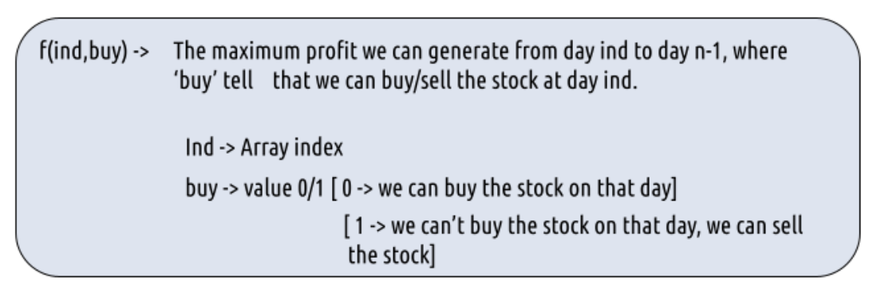
Subproblem definition

Slide 21
Recurrence Relation(s)?

Slide 22
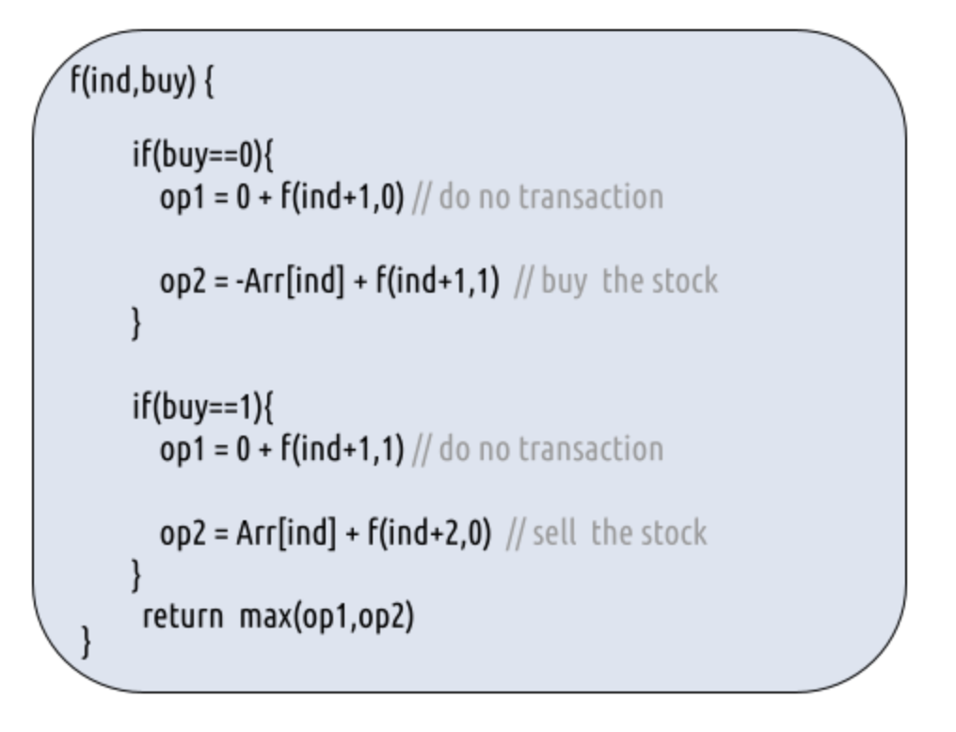
Recurrence relations and base cases
Base case - If ind>=n, it means we have finished trading on all days, and there is no more money that we can get, therefore we simply return 0.

Slide 23
pseudo-code
dp[ind][buy] = 0 wherever ind>=n
for ind from n - 1 to 0:
for buy from 0 to 1:
profit = 0
if buy == 0: // We can buy the stock
profit = max(0 + dp[ind + 1][0], -Arr[ind] + dp[ind + 1][1])
else if buy == 1: // We can sell the stock
profit = max(0 + dp[ind + 1][1], Arr[ind] + dp[ind + 2][0])
dp[ind][buy] = profit
// The maximum profit is stored in dp[0][0]
return dp[0][0]

Slide 24
Complexities
Time complexity - O(2*n)
Space complexity - O(2*n) (can it be reduced?)

Slide 25
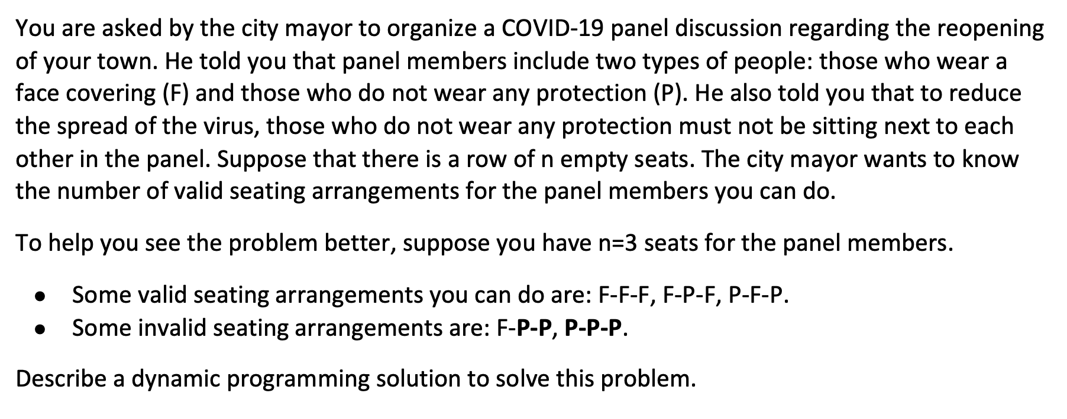
Question 1

Slide 26
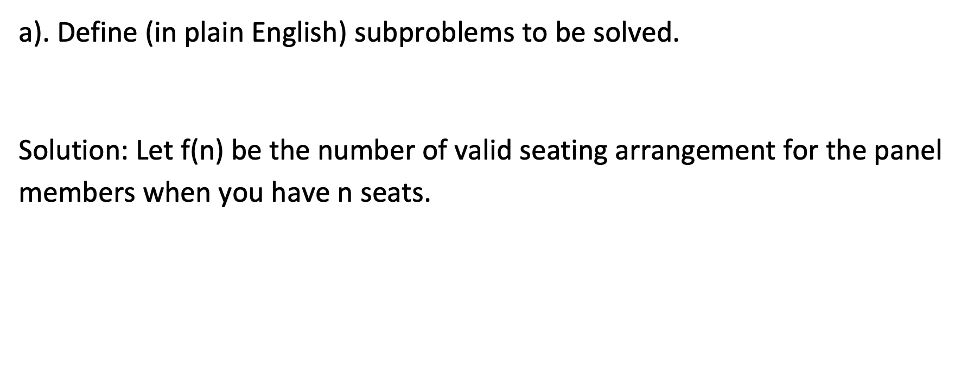
Question 1

Slide 27
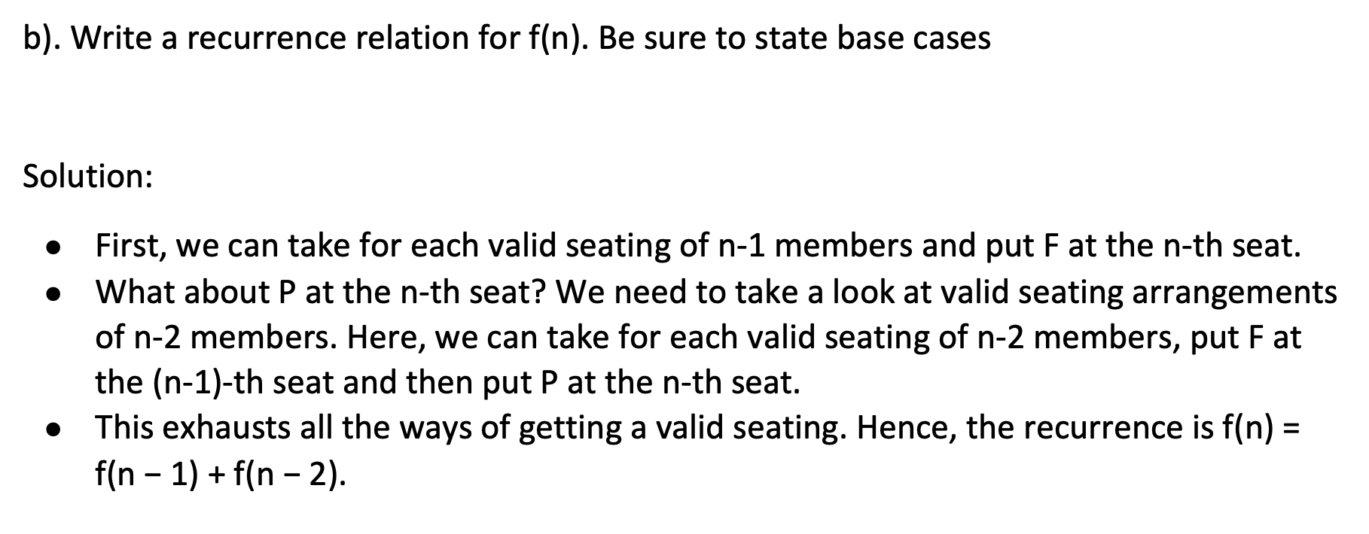
Question 1

Slide 28
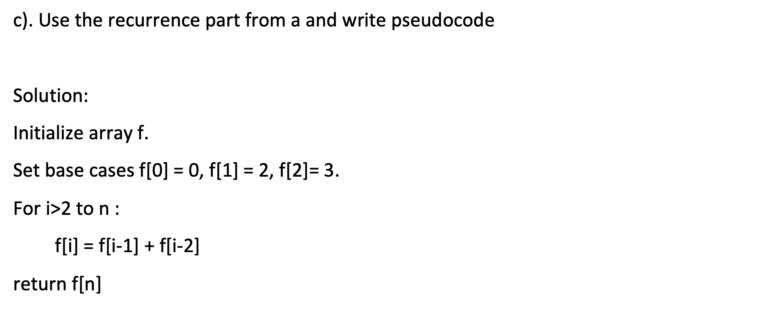
Question 1

Slide 29
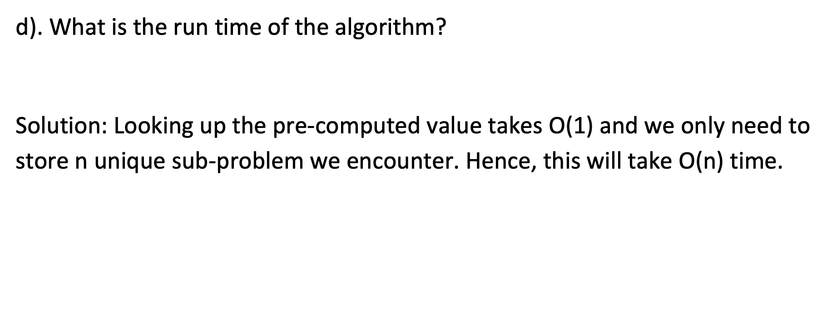
Question 1

Slide 30
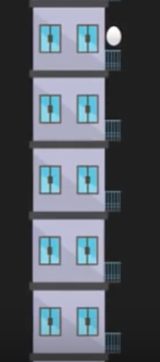
Question 2
Suppose you are in an n-story building and you have k eggs in your bag. You want to find out the lowest floor from which dropping an egg will break it. What is the minimum number of egg-dropping trials that is sufficient for finding out the answer in all possible cases?

Slide 31
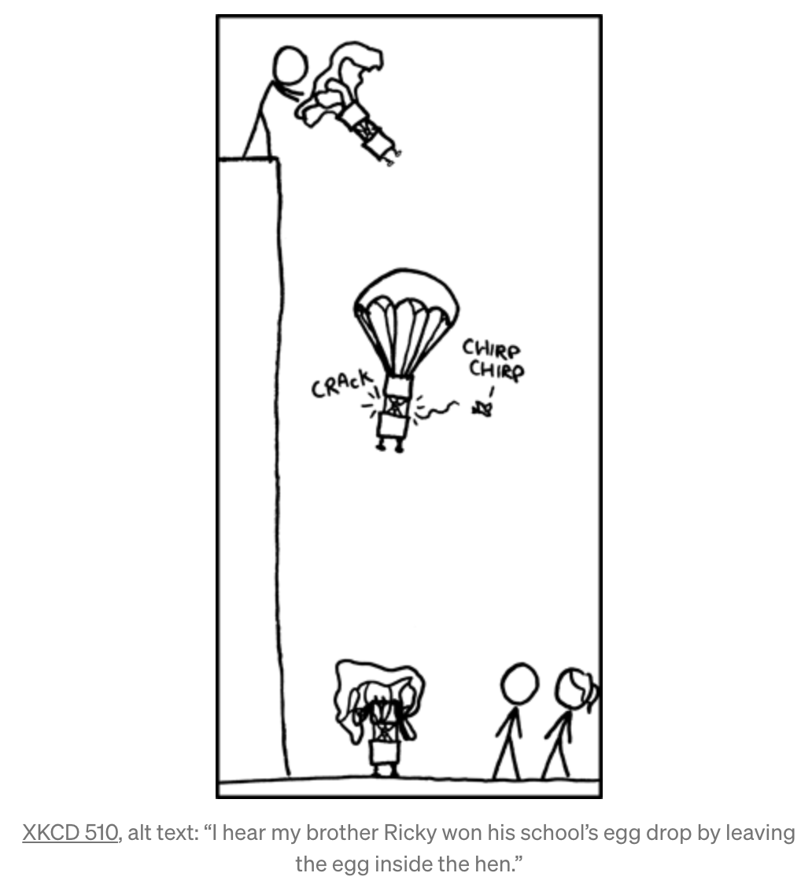
Question 2: Example
For example, if the building has 100 floors (n = 100)
we have only 1 egg, then we must do 100 trials to find the threshold
we have 2 eggs, then we can find the threshold in 14 trials!

Slide 32
Question 2: Constraints
Following are the constraints:
An egg that survives a fall can be used again.
A broken egg must be discarded.
The effect of a fall is the same for all eggs.
If an egg breaks from a fall, then it would break if dropped from a higher floor.
If an egg survives a fall then it would survive a shorter fall.
Remember, We are finding the least number of drops to find the threshold floor and not the threshold floor itself!

Slide 33
Question 2: Base Cases
If we there are n floors and 1 egg, we need to do n trials worst case
If there are k eggs and 0 floors, we would need to do 0 trials
If there are k eggs and 1 floor, we need to do 1 trial

Slide 34
Define the subproblem
Let OPT[i, j] denote the minimum number of trials required for an i story building and j eggs

Slide 35
Find the Recurrence for OPT[i, j]
Obtain OPT[i, j] given all the results of the solved subproblems
Suppose we first drop an egg from floor x <= i.
If the egg breaks, then we learn that threshold <= x, but we are left with j - 1 eggs. To find out the threshold from this state we would need extra OPT[x – 1, j - 1] steps.
If the egg doesn’t break, then we learn that x < threshold and we still have k eggs. All the above (i - x) floors are the possible candidates and we have j eggs. Therefore, we would need to do OPT[i – x, j] extra steps.
We must traverse for each floor x from 1 to i to find the minimum
OPT[i, j] = min_{1<=x<=i}{1 + max(OPT[x – 1, j - 1], OPT[i – x, j])}

Slide 36
PseudoCode
Base Case:
OPT[0, j] = 0; // 0 floor
OPT[1, j] = 1; // 1 floor
OPT[i, 1] = i; // 1 egg
OPT[i, j] = MAX_INTEGER, otherwise
Iteration:
for j = 2 to k:
for i = 2 to n:
for x = 1 to i:
OPT[i, j] = min(OPT[i, j], 1 + max(OPT[x – 1, j - 1], OPT[i – x, j]))
Return OPT[n, k]

Slide 37
Complexity Analysis
Time complexity is O(n²k)
Space complexity is O(nk)

Slide 38
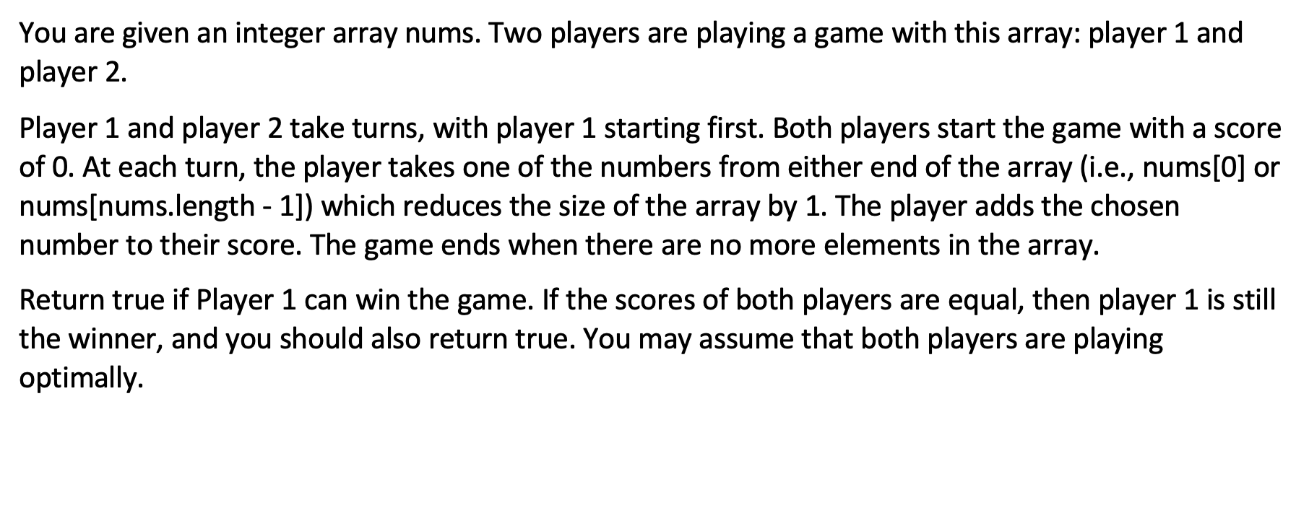
Question 3

Slide 39
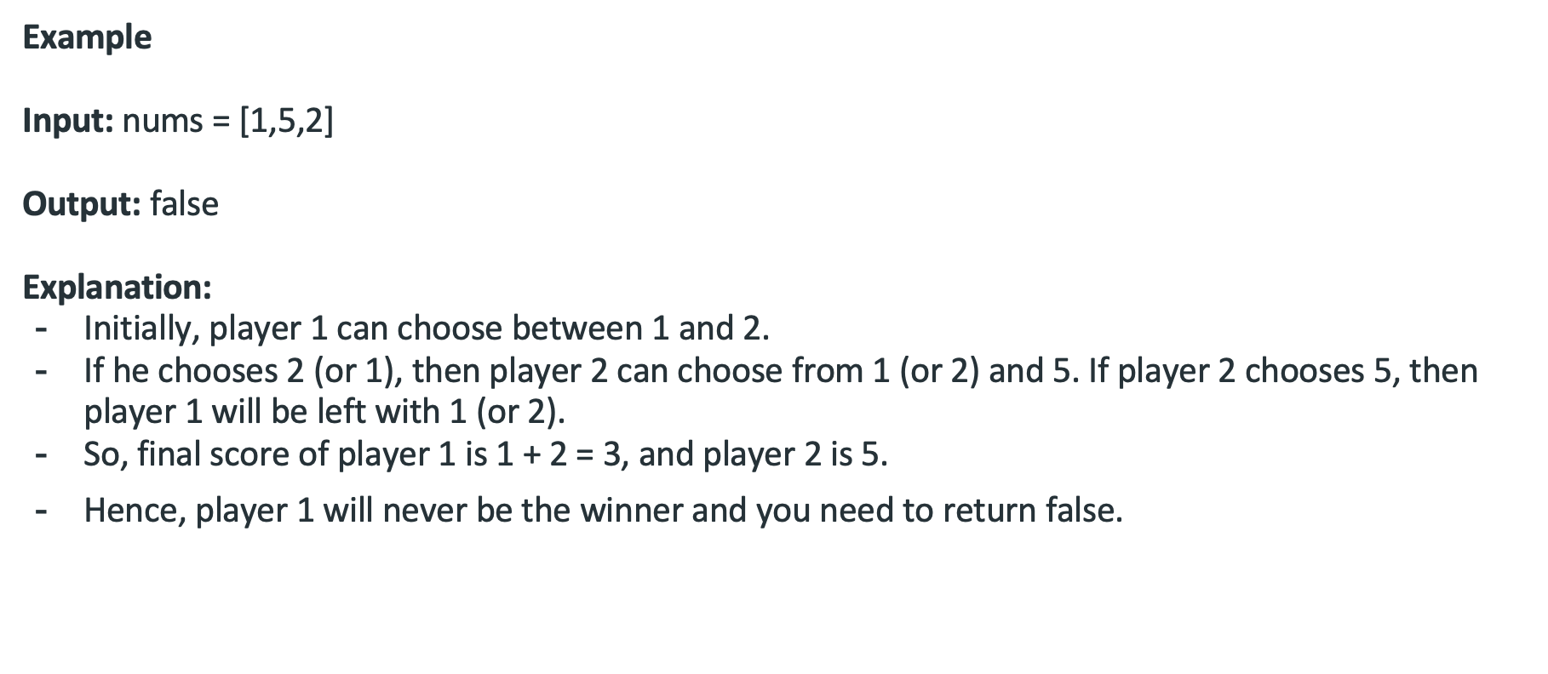
Question 3

Slide 40
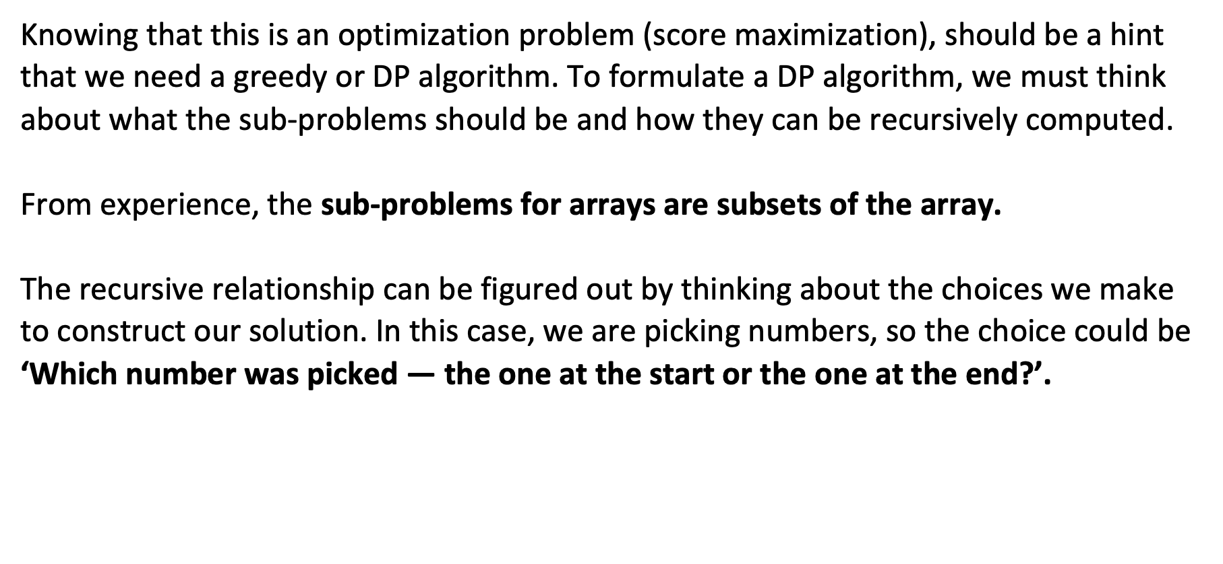
Question 3

Slide 41
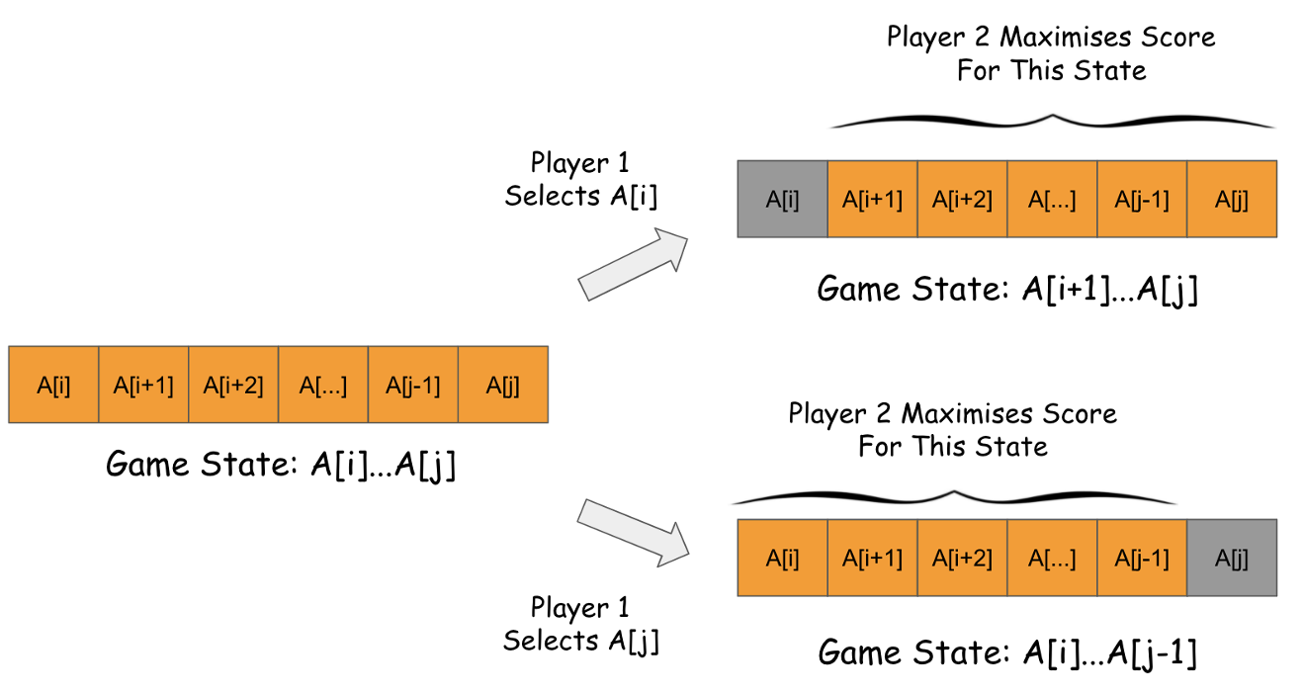
Question 3

Slide 42
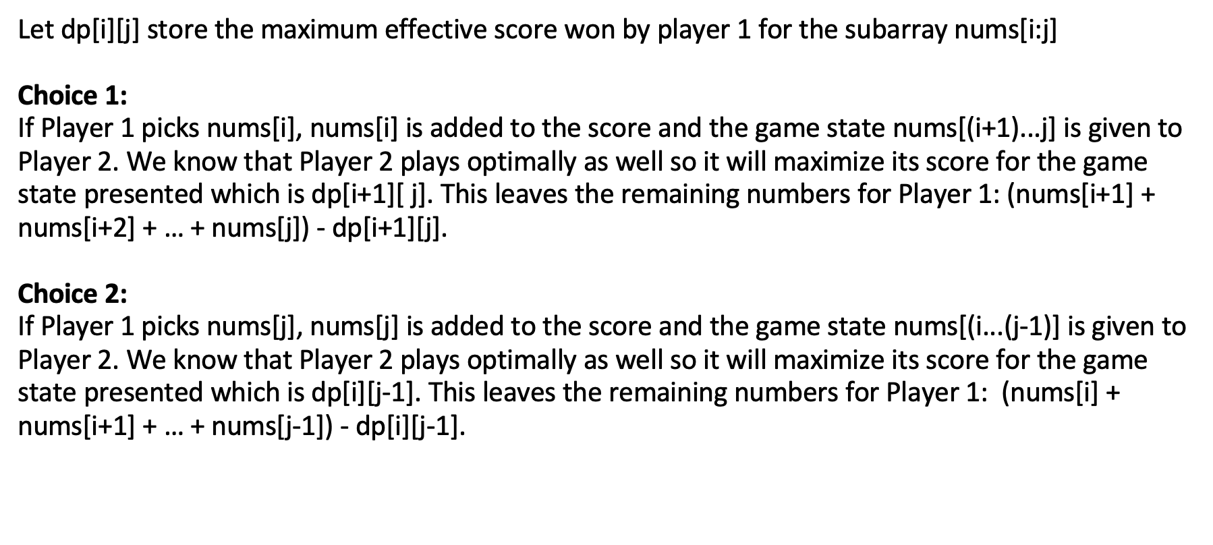
Question 3

Slide 43
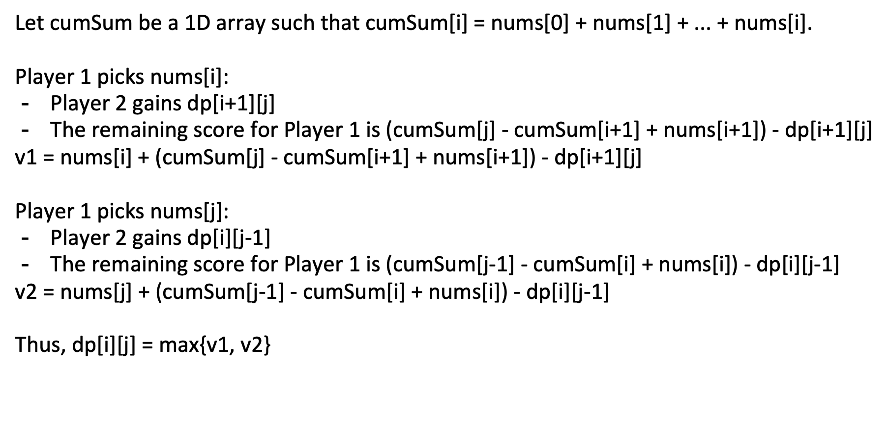
Question 3

Slide 44
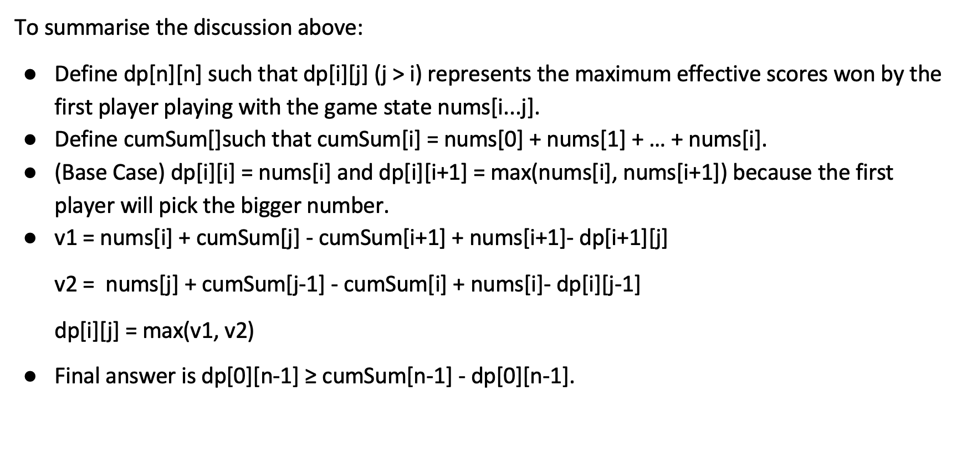
Question 3

Slide 45
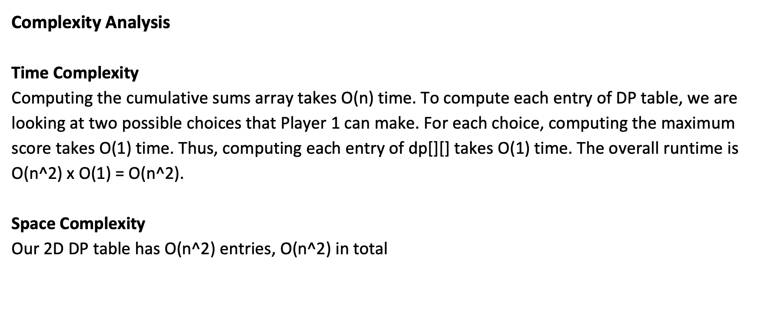
Question 3

Slide 46
Network Flow

Slide 47
True/False

Slide 48
True/False
True!

Slide 49
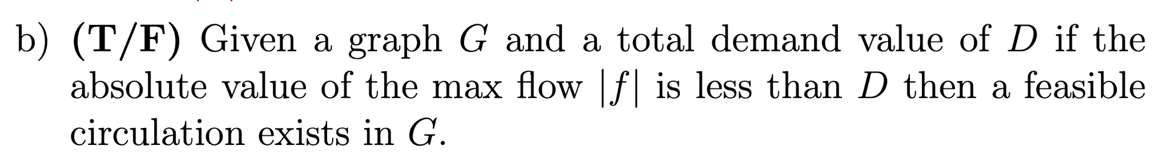
True/False
False.

Slide 50
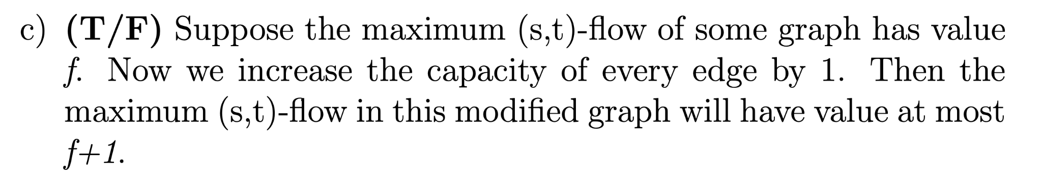
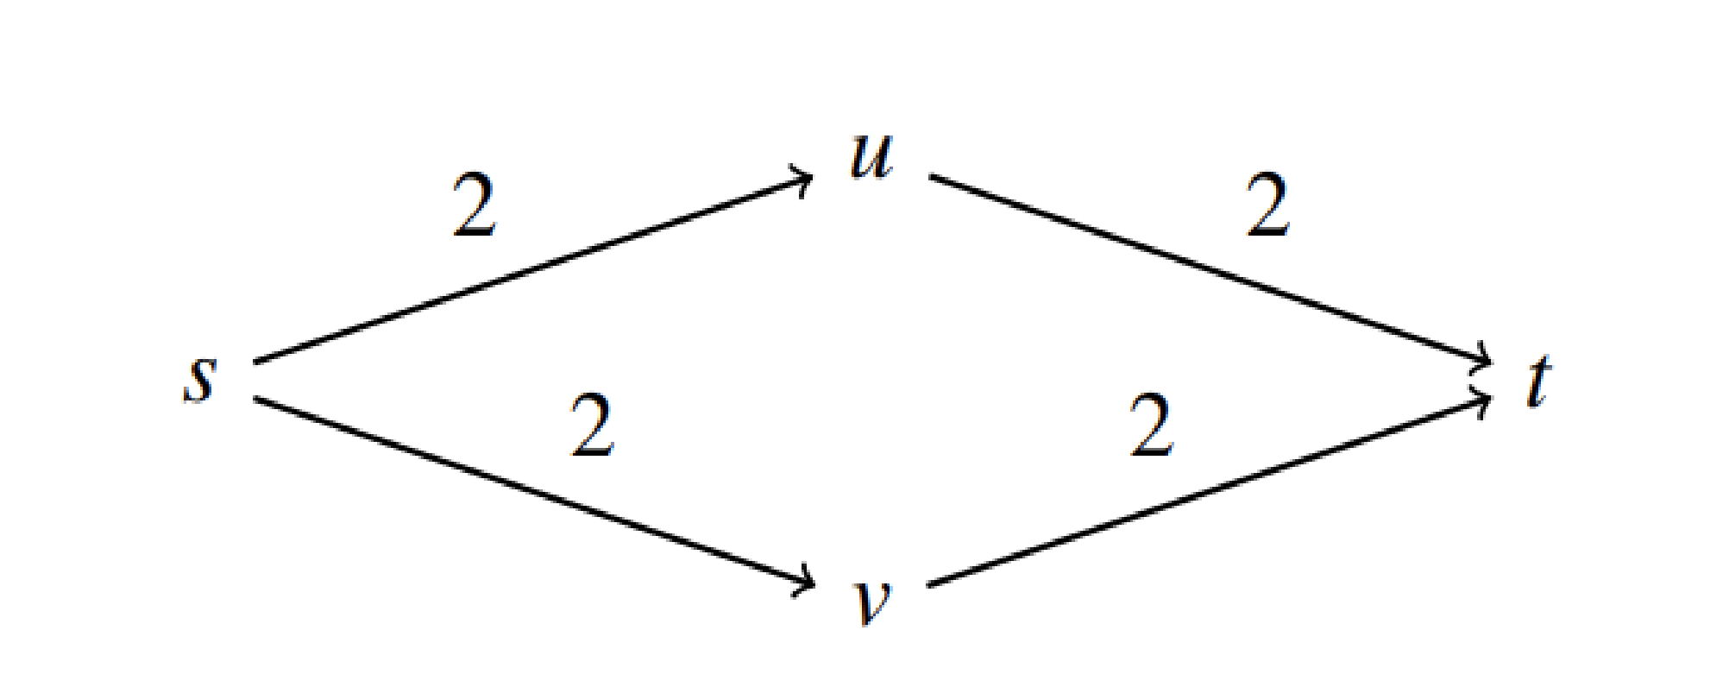
True/False
False. Consider the counterexample.

Slide 51
Questions

Slide 52
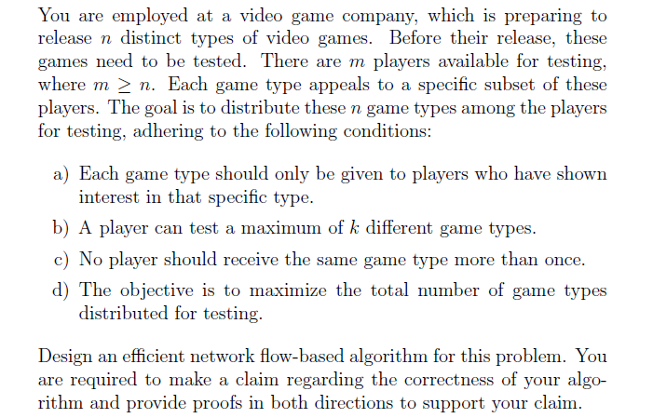
Network Flow

Slide 53
Step 1: Nodes
Look into the objects in the problem statement.
Two kinds of nodes: game types, and players.
The players need to “test” the game types. The relationship “test” can be regarded as one kind of edges. Importantly, one test of the player to the game type is regarded as one unit of flow.

Slide 54
Step 2: Constraints
Only the players in P[i] can test game type i
Look into the related constraints in the problem statement.
A player can test at most K game types
A player at most tests a game type once

Slide 55
Step 3: Convert Constraints
Constraint 1: only the players in P[i] can test game type i
=> create edges from game type i to the players in P[i]
Constraint 2: a player can test at most K times
=> create edges from player to sink
set the capacity of these edges to K
Usually, if the constraint is only related to one type of nodes, the converted edges would be linked with source of sink node.
Constraint 3: a player at most tests a game type once
=> set the capacity for edges between game types and players to 1.

Slide 56
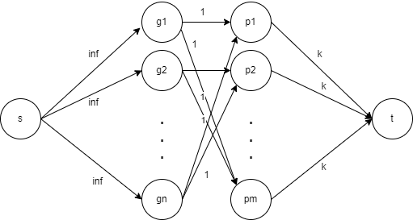
Step 4: Objective, and Other Edges
In other words, maximize the number of tests
Set the capacity to infinity

Slide 57
Follow Up Question
If the objective is to maximize the number of tested game types, what modifications do we need to make?
Set the capacity to 1

Slide 58
Proof
Don’t forget to prove the correctness of your designed algorithm!
The claim is required! Usually, “the desired answer of this question is equal to the maxflow (or sth else) of the constructed graph G.
Proofs in both directions.
You need to show that:
(1) If desired answer of this question is A, then the maxflow equals to A;
(2) if the maxflow is A, then the desired answer is A.

Slide 59
Network Flow Solution
Claim: We can maximize the total number of video games given if and only if we maximize the flow in graph G.
Forward: Any flow translates to a valid solution (satisfying all the constraints)
Backward: Any valid solution to the distribution problem can be mapped to a valid flow for the graph.
Flow out of s is the total number of games distributed. Therefore, we maximize the total number of games distributed for testing.

Slide 60
Circulation
Review Session - Exam 2
CSCI 570 Spring 2024

Slide 61
Circulation with Demands and Lower Bounds
Given a directed graph G = (V, E), demands d(v) for each vertex v, and lower bounds l(e) and capacities c(e) for each edge e, the circulation problem asks you to find a flow f such that:
f ^{in} (v) - f ^{out} (v) = d(v) for all v ∈ V
l(e) ≤ f(e) ≤ c(e) for all e ∈ E
d(v)
l(e)
c(e)
-10
A
[6,9]
[1,4]
[0,2]
B
1
3
C
[2,4]
[0,2]
6
D

Slide 62
Finding Circulation
Solution
Set flow f₁(e) = l(e) for all edges e
f₁(e)
-10
A
6
1
0
B
1
3
C
2
0
6
D

Slide 63
Finding Circulation
Solution
Set flow f₁(e) = l(e) for all edges e
Calculate the imbalance L(v) at each vertex v L(v) = f₁^{in} (v) - f₁^{out} (v)
A
L(v) = -7
-10
6
1
B
0
C
L(v) = 4
1
3
L(v) = 1
2
0
6
D
L(v) = 2

Slide 64
Finding Circulation
Solution
Set new demand d ^{new}(v) for each vertex v d ^{new}(v) = d ^{old}(v) - L(v)
A
d(v) = -10 - (-7) = -3
-3
6
1
B
0
C
d(v) = 1 - 4 = -3
-3
2
L(v) = 3 - 1 = 2
2
0
4
D
L(v) = 6 - 2 = 4

Slide 65
Finding Circulation
Solution
Set new demand d ^{new}(v) for each vertex v d ^{new}(v) = d ^{old}(v) - L(v)
Set new capacity c ^{new}(e) for each edge e c ^{new}(e) = c ^{old}(e) - l(e)
-3
A
9 - 6 = 3
4 - 1 = 3
2 - 0 = 2
B
-3
2
C
4 - 2 = 2
2 - 0 = 2
4
D

Slide 66
Finding Circulation
Solution
We have converted the problem of finding circulation with demands + lower bounds to finding circulation with demands only
d ^{new}(v)
c ^{new}(e)
-3
A
3
3
2
B
-3
2
C
2
2
4
D

Slide 67
Finding Circulation
Solution
Connect vertices with negative demands to supersource s, and vertices with positive demands with supersink t V = V U {s, t} E = E U { (s, u) | d(u) < 0 } U { (v, t) | d(v) > 0}
s
-3
A
3
3
2
B
-3
2
C
2
2
4
D
t

Slide 68
Finding Circulation
Solution
Set c(s, u) = -d(u) and c(v, t) = d(v) Set d(v) = 0 for all vertex v ∈ V - {s, t}
s
3
A
3
3
3
2
B
C
2
2
2
D
4
t

Slide 69
Finding Circulation
Solution
Set c(s, u) = -d(u) and c(v, t) = d(v) Set d(v) = 0 for all vertex v ∈ V - {s, t}
Find maximum flow f₂ in the new network
f₁(e)
s
3/3
A
3/3
1/3
2/3
2/2
B
C
2/2
2/2
2/2
D
4/4
t

Slide 70
Finding Circulation
Solution
Set f = f₁ + f₂ Remove s and t The flow f is the solution
f₁(e)
f₂(e)
f(e)
-10
A
6 + 1 = 7
1 + 2 = 3
0 + 2 = 2
B
1
3
C
2 + 2 = 4
0 + 2 = 2
6
D

Slide 71
Problem
For Fall & Spring 2024, n students want to graduate. There are m total courses. Following conditions should be met across both semesters:
Student i must take r_{i} number of courses.
Student i must take specific compulsory courses belonging to set T_{i} .
Course j needs p_{j} number of students to start the course, no more or less.
Courses in set U are offered in both semesters and can be taken at most twice. All other courses are offered in one of the semesters and can be taken at most once. Taking a course in set U twice will contribute two units towards the total number of courses taken by the student.
Please design an algorithm to determine if all students can graduate.

Slide 72
Solution
We will solve this problem by finding a feasible circulation in a flow network.
Create n vertices for students, and m vertices for courses. Add an edge from each student vertex to course vertex.
Students
Courses

Slide 73
Solution
Student i must take r_{i} number of courses. Therefore, put a demand of -r_{i} on student vertex i. Course j needs p_{j} number of students to start the course. Therefore, we put a demand of p_{j} on course vertex j.
-r₁
p₁
-r₂
p₂
-r₃
p₃
-r₄
Students
Courses

Slide 74
Solution
Courses in set U can be taken at most twice. All other courses can be taken at most once. Therefore, we put a capacity of 2 on edges adjacent to a course vertex ∈ U, and a capacity of 1 on all other edges.
c(e) = 1
-r₁
p₁
-r₂
p₂
-r₃
p₃
-r₄
c(e) = 2
Students
Courses

Slide 75
Solution
Student i must take specific compulsory courses belonging to set T_{i} .
We put a lower bound of 1 on edges (i, j) if j ∈ T_{i}
c(e) = 1
-r₁
p₁
-r₂
p₂
-r₃
l(e) = 1
p₃
-r₄
c(e) = 2
Students
Courses

Slide 76
Solution
We solve the circulation with demands and lower bounds using the method we discussed earlier
c(e) = 1
-r₁
p₁
-r₂
p₂
-r₃
l(e) = 1
p₃
-r₄
c(e) = 2
Students
Courses

